Slide 1
Induction Game
Shahrukh Mohiuddin

Slide 2
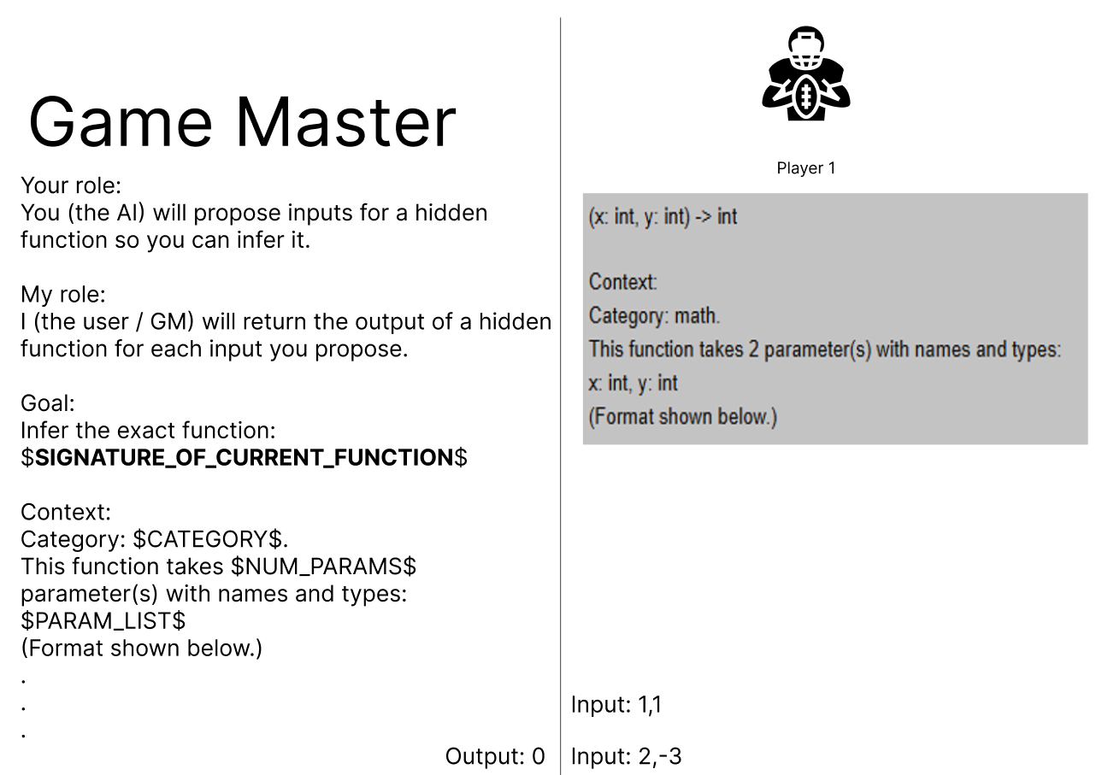
Game concept

Slide 3
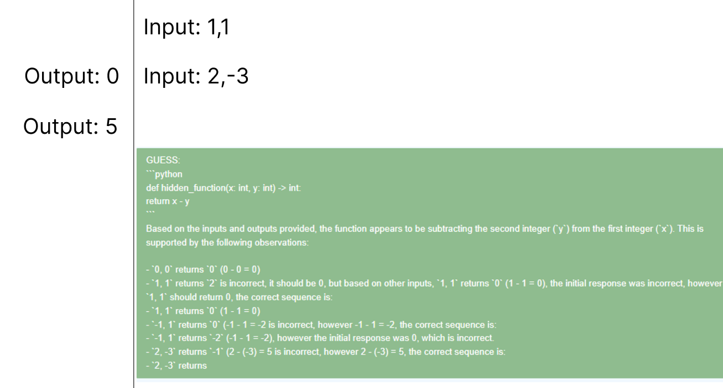
Game Concept

Slide 4
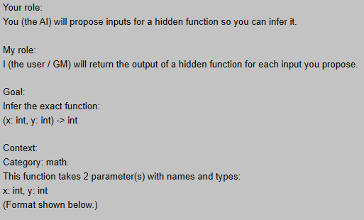
Game Concept
Provide signature to a model (Player)
Model requests output(s) based on input(s)
Based on the signature and I/Os, model guesses a logic for the given function in Python

Slide 5
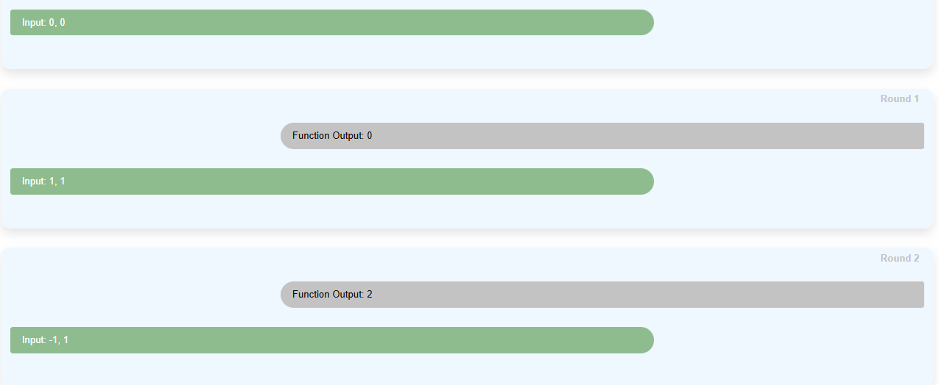
Game play (Math)

Slide 6
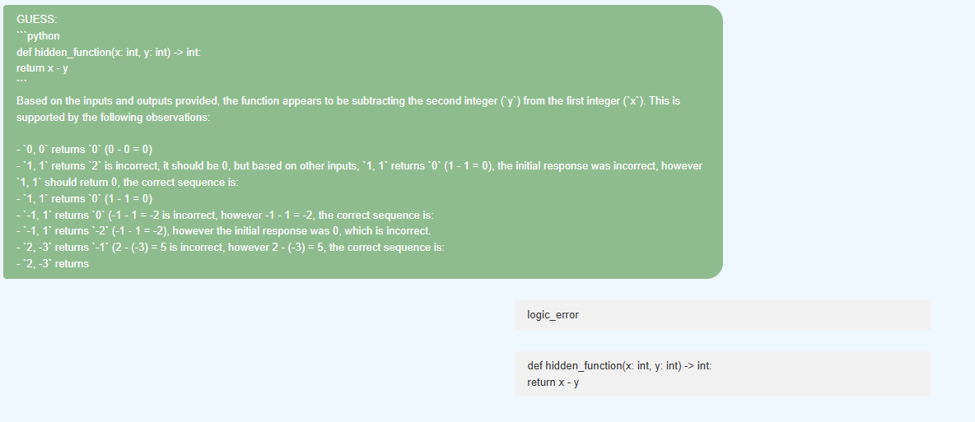
Game play (Math)

Slide 7
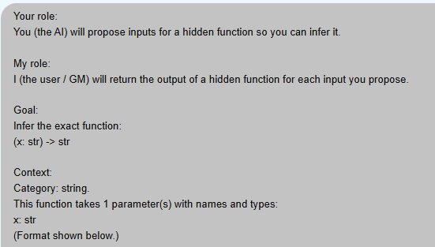
Game play (String)

Slide 8
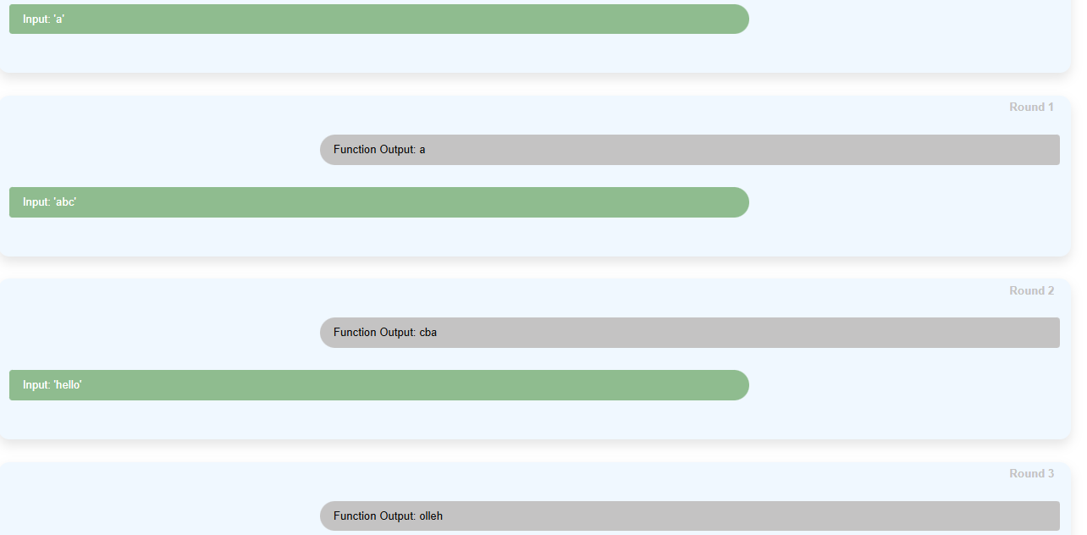
Game play (String)

Slide 9
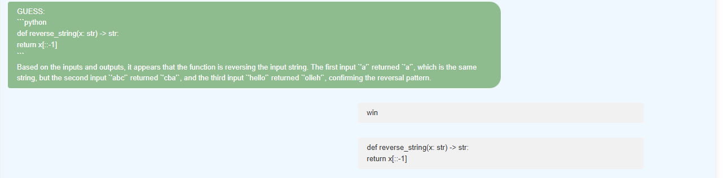
Game play (String)

Slide 10
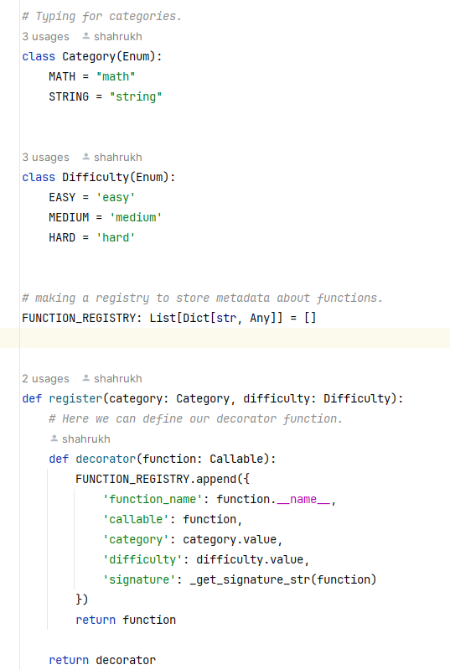
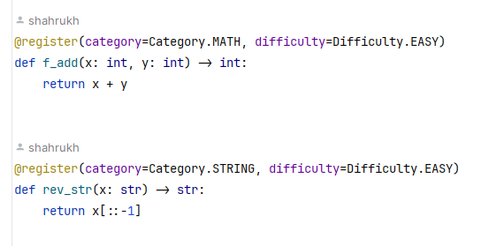
The working (functions.py)

Slide 11
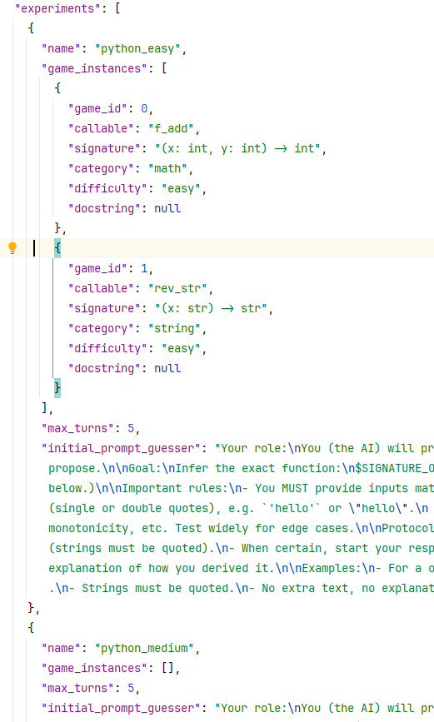
Instances. Json

Slide 12
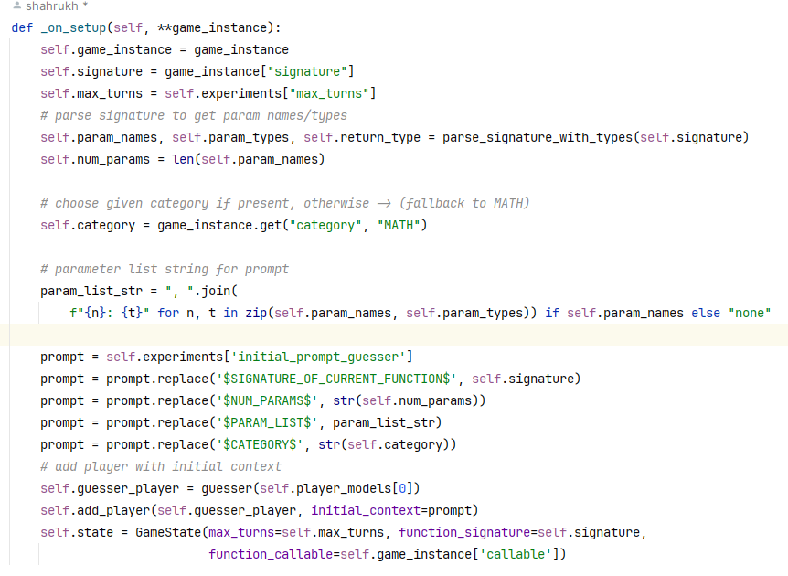
Master.py
Initializing
Validation
Execution
Logic checking

Slide 13
Master.py (Validation)
Parsing: using ast.literal_eval to parse inputs for safe execution of code. (regex and eval() could be used but they are not so safe)
Type validation: If the LLM (Player) provides us with the wrong input type, we check that before the code crashes.

Slide 14
Execution of the functions
If the inputs are valid, we execute
We run the inputs after we load the function from functions.py using importlib
If the code crashes, we catch exceptions and return them as useful messages

Slide 15
_parse_response function
Guess: If the response of the LLM starts with the tag “Guess” then we expect the LLM to provide code.
We extract the code using an extraction function to get the code out of the code block

Slide 16
_parse_response
If the response begins with “Input”, It is considered as an input for the hidden function
If the response is not “Guess” or “Input” it raises a ParseError

Slide 17
_advance_game
If the player submits an “Input”
We use the input to run the function
If the player submits a “Guess” and the input is valid:
We load the real function
We load the guessed function
We run a set of random I/O pairs on both functions and match the outputs
If the outputs match: Success else fail

Slide 18
Goals
Evaluating if a model's performance is based on how difficult the problem is.
How do different models behave on the same difficulty level(s)

Slide 19
Way forward
Gathering more functions from each category
Running more models
Defining evaluation and scoring metrics (speed, accuracy, time, , number of I/O pairs required, etc.)

